Slide 1
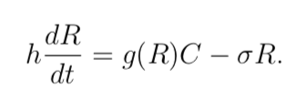

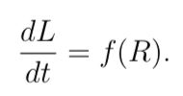
One-Dimensional Modeling of Plant Growth
Matthew Schwartz
Based on: Dynamical Modeling of Plants (N. Bessenov and V. Volpert)

Slide 2
Motivation
Questions:
How does plant growth depend on time?
How do biological factors affect the speed of growth and final sizes of plants?
What patterns emerge?

Slide 3
Assumptions
Enough, well distributed light. Photosynthesis will not be a limiting factor of metabolite production and thus need not be considered.
Plant growth assumed to start at ground (roots ignored), and nutrients are supplied from this point.
Proliferating cells are strongly localized to the growing end of the plant.
Constant plant width along stem.

Slide 4
The Model

Slide 5
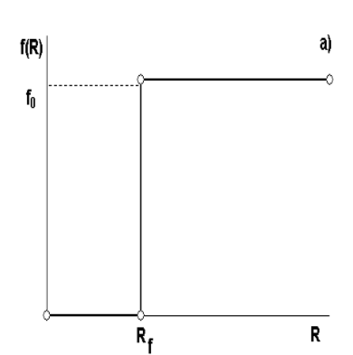
Binary Growth

Slide 6
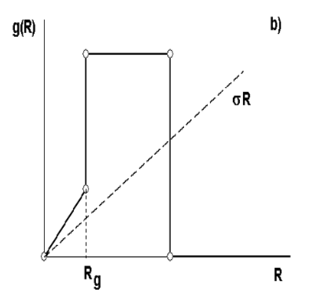
Growth Factor

Slide 7


Concentration of Metabolites

Slide 8
Plant 1.0
Simplification: treat C as a constant
(C = 1)
Gain: solve equations only at x = L(t). No
dependence on space, only on time.
Lose: interesting and meaningful physical
phenomena, such as steady state
solutions (final length of plant).

Slide 9
Issues encountered with Plant 1.0
Parameters
Analytical solution
Adaptive methods

Slide 10
Plant 2.0 and 3.0
Advance: treat C dynamically via the diffusion-advection equation.
Gain: new behaviors and more physically accurate model
Loss: time - takes more computing time (and time in effort to code).

Slide 11
Diffusion-Advection: Proof of Concept
Wrote a program to solve the Diffusion-Advection Equation via the Crank Nicholson method.
Tested with various boundary conditions, initial conditions, and parameters.
Compared with analytical solutions.

Slide 12
Issues encountered with Plant 2.0
Free boundary
Fine tuning parameters

Slide 13
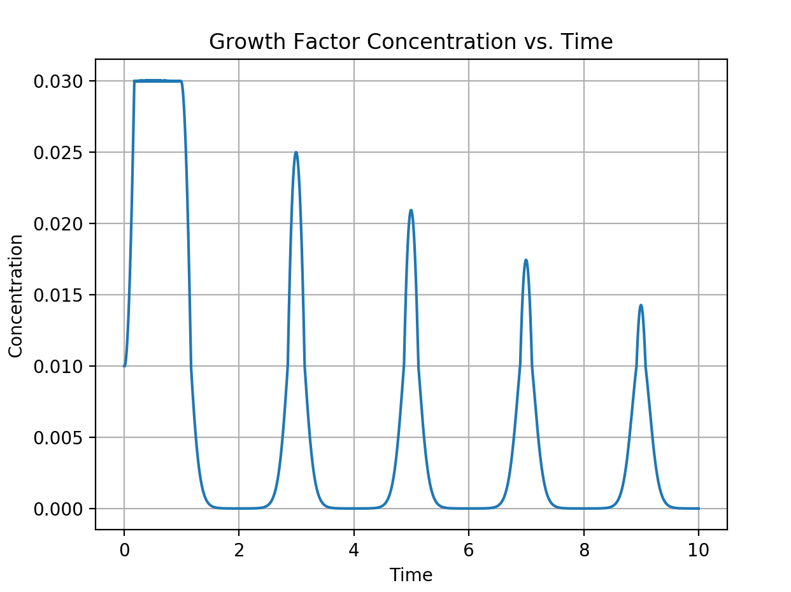
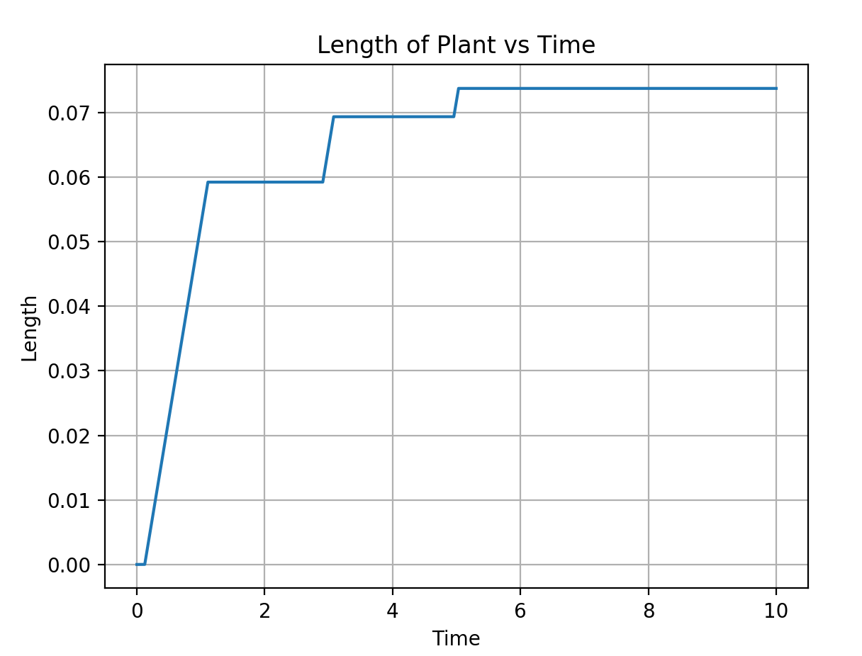
Plant 4.0 and Onwards

Slide 14
Conclusions
Changing h, the width of the plant:
Positive correlation between h and final length of plant.
Positive correlation between h and number of growing periods.
Plants are hard to grow!

